Slide 1
Using Technology to Communicate
By Dallon Bloxham
CIS 1020-023
04/10/2012

Slide 2
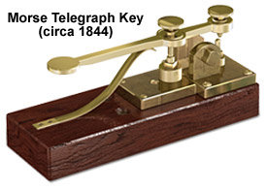
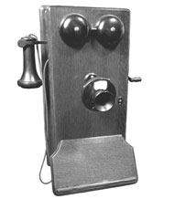

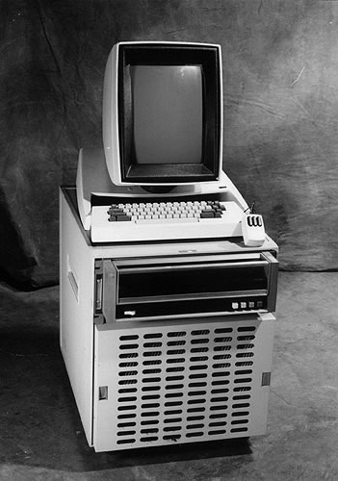
Technology's progression
The Advancement of technology has helped to improve the ways we communicate with each other. From….
Pen and Paper/ Printing Press
Morse Telegraph (1838)
Telephone (1848)
On To…..
Computers &
Computer Networking (1969)

Slide 3

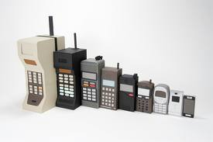
World Wide Web
Making light speed communication anywhere in the world.
&
Cell Phones and
Mobile Networks
Being able to be mobile and still available to communicate with people.
It is estimated that 250-300 million cell phones are currently being used in the U.S.

Slide 4



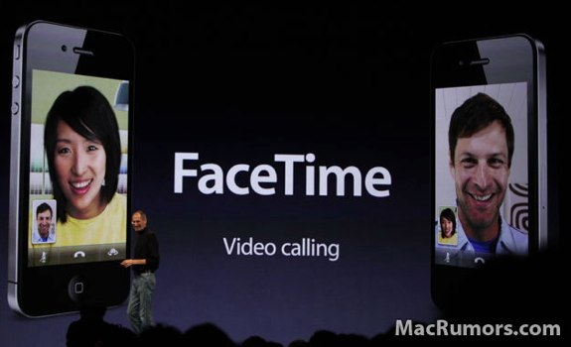


The Internet
Has made communication more convenient by creating more ways to communicate.
Has made staying in touch with people who live far away easy.
Has made communicating a message to a large number of people easier.
Some Examples:
Email-
Instant Messaging
Video Chat
Social Networks &
Blogs

Slide 5
The Internet > everything
The internet has changed all previous forms of mass communicating. Such as..
News Papers: News and information can be found on the internet and typically faster then the news papers.
Radio: has gone from local broadcasts to international podcasts.
TV: Can stream new or old broadcasts, or you can create your own.
Number of people who use the internet for their media
Newspaper | 40% down from 52 percent in 2006
Radio | Network radio reaches 87 percent of Adults aged 18-34
TV | 45% of TV Viewers Get Their Shows Online

Slide 6
In Conclusion..
Through the progression in communication technology people are able to communicate one on one or in bigger numbers with a lot more ease.
Do you think there are Negatives about communicating via Internet or Mobile phone?
Notes:
Bibliography
Fenell, Zachary. "http://www.ehow.com/facts_6175341_technology-made-communication-better_.html." November 20010. ehow.com.
Mc Luhan. "http://www.ehow.com/video_5112445_effects-technology-mass-communication.html." April 2011. ehow.com. 2012.
Salter, Alex Michel and Ben. "http://upload.wikimedia.org/wikipedia/commons/c/c4/Timeline_of_communication_tools.jpg." 2008. Book Marketing Media.
startacellphonebusiness.com. "http://startacellphonebusiness.com/articles/facts-about-cell-phones.html." March 2010.
medicalbillingandcoding.org. http://www.medicalbillingandcoding.org/facts-about-the-internet/. July 2010.

